Slide 1


Foundations of Entrepreneurship
Business Model Canvas
Lecture Note # 16
12.02.2021

Slide 2
Business model definition
Business model canvas template
Example

Slide 3
Business Model: Definition
A business model is an opportunity for a business with all its features including risks, advantages, complexities, customer segment, market structure & potential, competition landscape, socio-political challenges and opportunities, commercial attractiveness, environmental challenges, techno-economic feasibility, profitable sustainability, growth potential, legal tenability and the execution plan.
A business model describes the rationale of how an organization creates, delivers, and captures value – Alexander Osterwalder

Slide 4
A business model describes the rationale of how an organization creates, delivers, and captures value, in economic, social, cultural or other contexts. The process of business model construction and modification is also called business model innovation and forms a part of business strategy.

Slide 5
Business Plan
Business plan is a document containing the detailed plan of execution of a Business Model, its unique strengths, weaknesses, opportunities, threats, the complementary skills of the team, operation plan, marketing plan and the financial projections, demonstrating how the company acquire, retain and grow customer base, create value for customers and other stakeholders, derives competitive advantages, sustain and grow in the long run.

Slide 6
Business Model Innovation
Starting from identifying the pain point, Business Model innovation includes developing solutions, sustaining profitable growth and creating value for companies, customers, and society.
It is about innovating new products, process, services, and businesses replacing outdated models.
Apple created an innovative new business model with its iPod digital media player and iTunes online music store.
Skype brought us cheap global calling and free Skype-to-Skype calls with an innovative business model built on peer-to-peer technology. So has done WhatsApp.
Grameen Bank, in Bangladesh, is promoting social entrepreneurship and alleviating poverty through innovative micro-lending to the poor.
Notes:
all-pervading

Slide 7
Business Model Template
Thankfully for us, Alexander Osterwalder has developed a template for business model.
It is known as Business Model Canvas.
Notes:
all-pervading

Slide 8
Business Model Canvas
Alexander Osterwalder has presented nine building blocks for describing business model.
These blocks are arranged in a canvas, called Business Model Canvas.
The heart of the canvas is the Value Proposition and the Customer Segment blocks.
Any business is related to customers and customers are there for the value provided to them through the product or service and they would provide profit to the company .

Slide 9
Data Show that:
7 out of 10 products flop (in Silicon Valley)
All the money, time, resources and talent that go into making these 7 products are all wasted.
Majority, if not all, of the products fail because the targeted customers do not buy them.
They do not buy because they do not find them attractive.
They do not find them attractive because these products are unable to meet customers' essential needs.
42% Well-Funded startups fail.

Slide 10
Wufoo founded by Kevin Hale
Founded in 2006 and exited in 2011
Raised only $1,18,000
Sold to SurveyMonkey for $35 million in 2011.
Gave a return of 29,561% to investors.
Product: A web app that lets people create forms
Motivation for the product: “We looked at other form builders, and we were like, ‘All these people are crappy. And we don’t want to be in that space.”

Slide 11
Value Proposition
A VALUE PROPOSITION represents the sum total of features of your product or service that customer would perceive as value for their money.
Your value proposition would provide reasons why customers would prefer to buy your product or service over those of competitors.

Slide 12
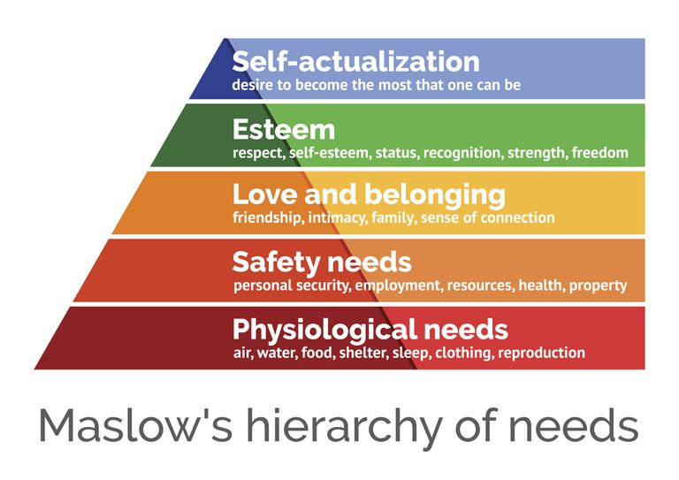
Know Your Customers’ Aspiration

Slide 13
Create a Correct Buyer-Persona
A buyer-persona (a.k.a. “customer avatar”) is a semi-fictional person who represents your ideal customer.
The objective of defining a ‘buyer persona’ is to get crystal clear on the individuals who you are marketing to.
Until you nail this down, you can’t really be sure that your offerings and your marketing messaging are going to be successful. That’s why the buyer persona is often based on real customers, and/or extensive research.

Slide 14
Value Proposition Value proposition is the sum total of the benefits of product or service to be offered including:
Quality
Efficacy
Usefulness
Esteem
Ease of installation
Configuration
Maintainability
Safety
Ease of use
Re-sale value
Power efficiency
Serviceability
Storability
Shelf-life
After-sale service
Reliability
Cost
Warranty
Aesthetic value
Convenience to buy
Delivery
Return policy
Trouble shooting and such.

Slide 15

Example: Failed because they did not focus on value proposition
The Iridium communications service or Iridium SSC was launched on November 1, 1998 at a capital investment of US$6 billion (Indian ₹ 42,000 crore).
Motorola was the technology provider.
This was launched at a time when cell phone service was in its infancy.
What the founder assumed?
Communication made possible from anywhere to anywhere. People have every reason to lap it up.
Image courtesy: http://i-marineapps.blogspot.com
Notes:
A glaring example is of Irridium and the first call was made by the then Vice President of the United States Al Gore to Gilbert Grosvenor, the great-grandson of Alexander Graham Bell.

Slide 16
Why did Iridium fail?
The company lacked idea of the cost of the service, affordability, usefulness of the product and adequacy of supporting technologies.
Customers were not ready to pay the price of the product and service.
The products did not meet requirements of customers.
The technology was ahead of time.
Ancillary industries were not well developed.

Slide 17
Value Proposition Template
Value proposition may be succinct one-liner or it may be elaborate for clear understanding.
The book by Alex Osterwalder has provided a template for a one-liner value proposition.
Your business’s value proposition is arguably the most important element of your overall market messaging.
A value proposition tells prospects why they should do business with you rather than your competitors, and makes the benefits of your products or services crystal clear from the outset.

Slide 18
Some Value Proposition Statements
Uber – The Smartest Way to Get Around
Apple iPhone – The Experience ‘is’ the Product
Digit – Save Money Without Thinking About It
CrazyEgg – Website Behavior Tracking at an Unbeatable Price

Slide 19



Video by Osterwalder
https://strategyzer.com/canvas/value-proposition-canvas
Gain
Customer Segment
Customer Jobs
----------
----------
----------
Pain

Slide 20


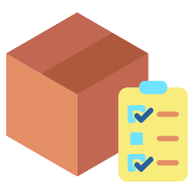

Value Proposition
Customer Segment
Gain creator
Gain
Products &
Services
Customer Jobs
----------
----------
----------
Product-market-fit
Pain
Pain relievers

Slide 21
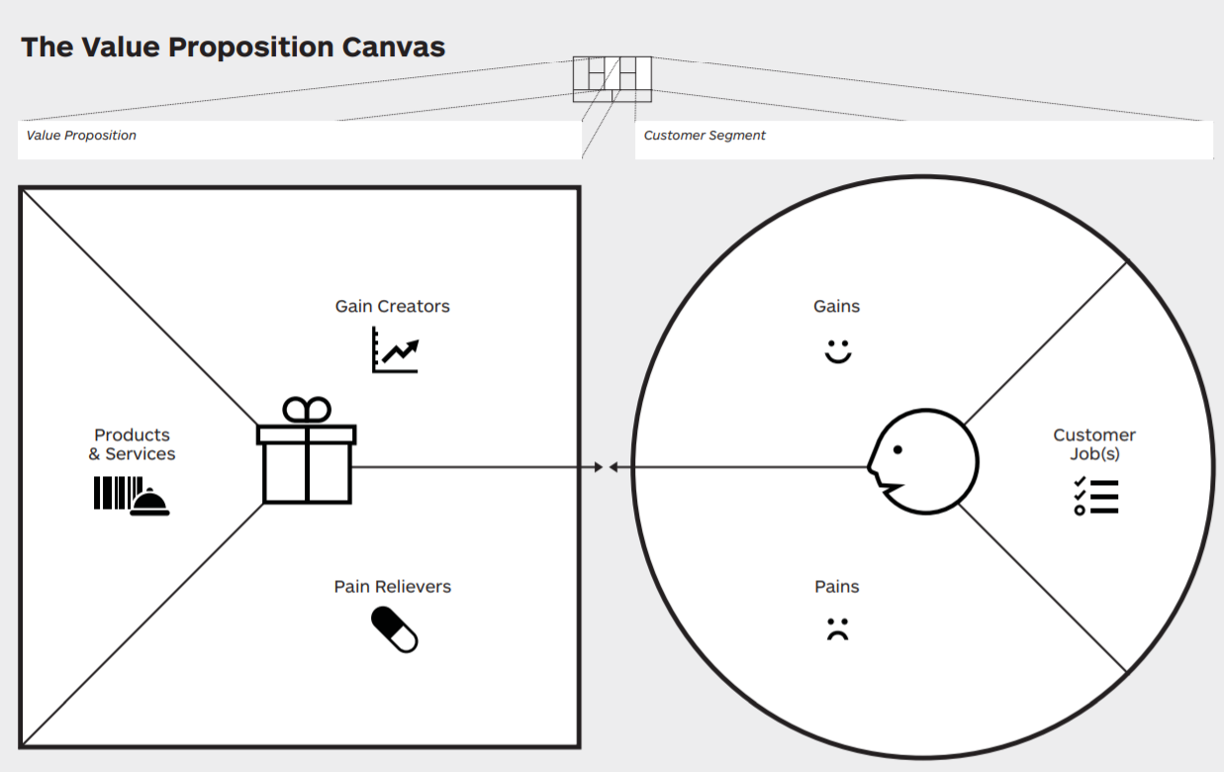
Professional driver
Rating system
Arrive on time
Schedule a trip
Professional
Recreated from the book: Value Proposition Design by Osterwalder
Fair price
Loyalty points
Call taxi
Visual map
Taxi aggregator with smartphone App
Easy payment
Find taxi
Save time
Anywhere anytime
Wait for a long time
Assign driver
Overcharged by taxi
Give direction
Cost system
Compete with other customers
Pay
Instant booking
No cash
Unsafe driver

Slide 22
Value Proposition
Must be defined as clearly as possible so that the advantages become glaringly and doubtlessly visible requiring no explanation (nobody will approach to get clarification. When in confusion, they would buy others’ product ).
State how your product better solves the problem than competition.

Slide 23
Value Proposition Is Usually a One-Sentence statement
Our (products or service) help(s) (customer segment) who want to (jobs to be done) by (your own verb such as reducing avoiding) and (your own verb such as increasing or enabling). You may also add a mild criticism of the competing products in general, writing (unlike: competing value proposition).
Our (book) help(s) (business professionals) who want to (improve or build a business) by (gaining latest knowledge on strategies) and (gaining deep insight) unlike books without focus on the real issues.

Slide 24
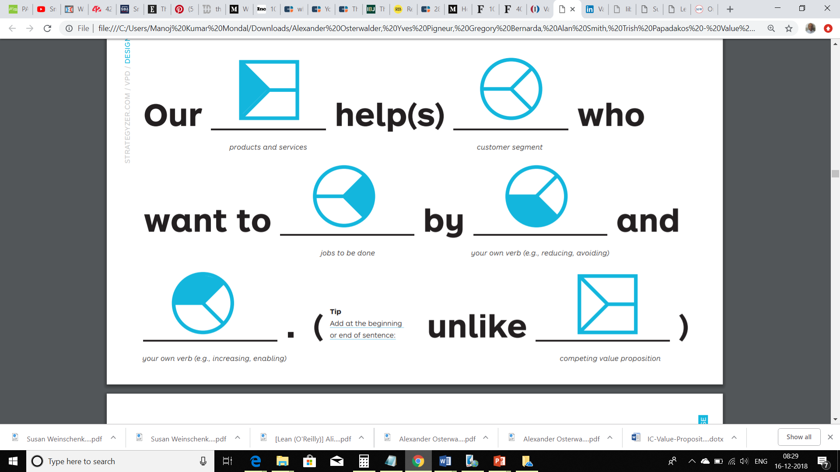
Our
help(s)
who want to
Product or service
Customer segment
Get them done
by
and
(unlike)
Existing products or services
Alleviating pains
Creating gains
Images are from the book: Value Proposition Design by Alexander Osterwalder

Slide 25
Value Proposition: Example of 10 carat gold jewelry
Our (jewelry) help(s) (affordability) of middle class people (to enjoy jewelry as glittering as the best gold ornament and increase happiness) by (buying more with less money) and (save money) unlike the 22 carat gold jewelry.
Our innovative technology, developed in advanced laboratory and crafted by the best professionals has created gold jewellery as glittering as any other gold jewellery that has enhance affordability and saving potentiality while increasing the happiness unlike any other jewelry available in the market.

Slide 26
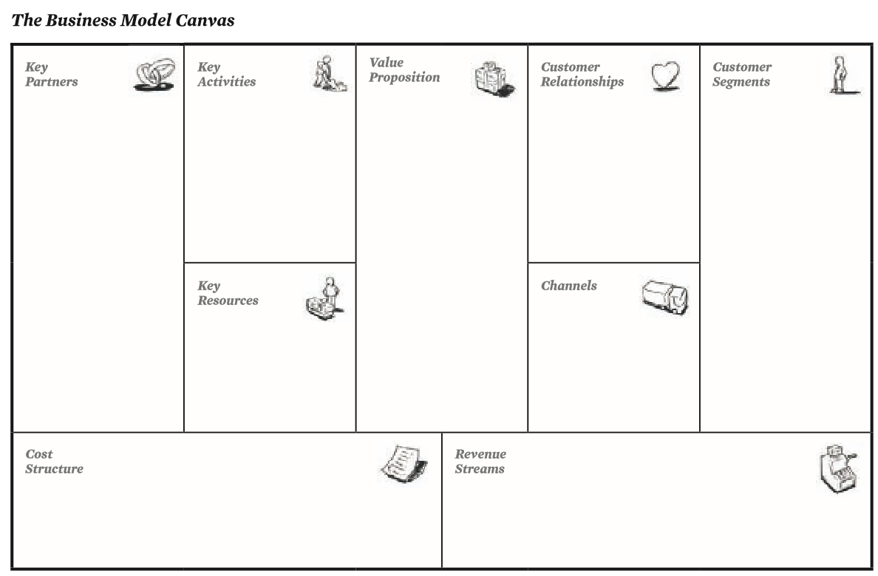
Business Model Canvas
Efficiency
Value
Book: Business Model Generation by Alexander Osterwalder, 2010

Slide 27
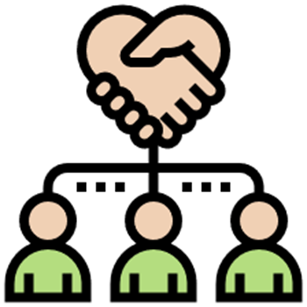


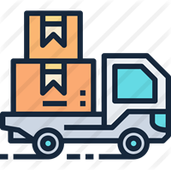
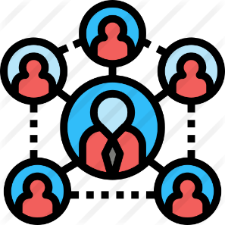

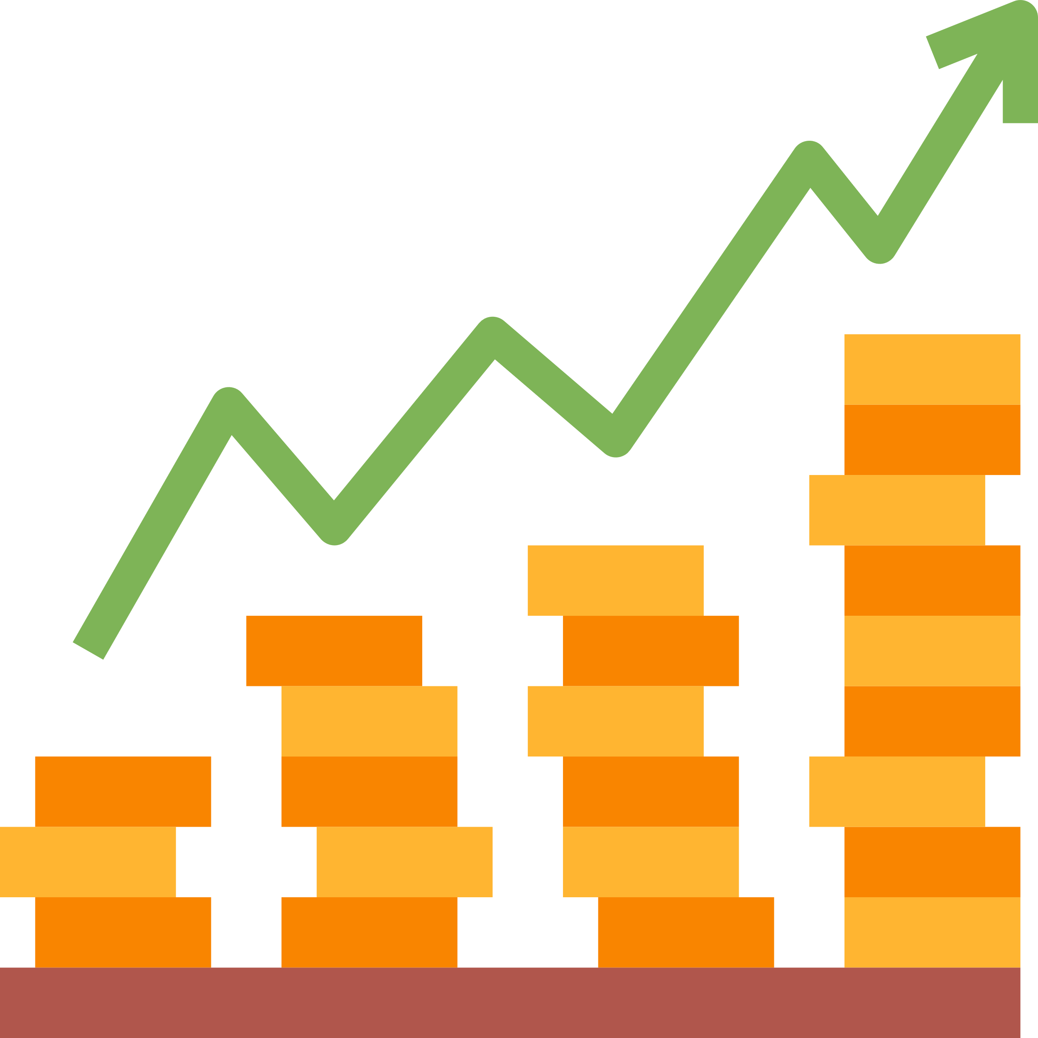

Customer Relationship
08
07
02
01
Value Proposition
04
Key Partners
Key Activities
Customer Segment
03
Key Resources
Channel
06
Revenue Model
05
09
Cost Structure

Slide 28
Customer Relationship
08
07
02
01
Value Proposition
04
Key Partners
Key Activities
Customer Segment
03
Key Resources
06
Channel
Revenue Model
05
09
Cost Structure

Slide 29
Customer Relationship
08
07
02
01
Value Proposition
04
Key Partners
Key Activities
Customer Segment
03
Key Resources
06
Channel
Revenue Model
05
09
Cost Structure

Slide 30

01
Customer Relationship
08
07
Value Proposition
02
04
Customer Segment
Key Partners
Key Activities
03
Key Resources
06
Channel
Revenue Model
05
09
Cost Structure

Slide 31
Value Proposition
The Value Propositions Building Block describes the favorable features of products and services that would be perceived by the customers in the targeted segment as superior value for money.
The Value Proposition provides reasons to customers why they would buy product of one company over another.
Customers would consider the bundle of features and the price to be paid vis-à-vis with those of competing products.

Slide 32
01
Customer Relationship
02
08
07
Value Proposition
04
Customer Segment
Key Partners
Key Activities
03
Key Resources
06
Channel
Revenue Model
05
09
Cost Structure

Slide 33
Market / Customer Segment
Market segmentation is the act of dividing a broad consumer or business population into sub-groups of consumers based on some shared characteristics relevant for marketing particular product or service.
Dividing the market for common characteristics such as similar needs, common interests, similar lifestyles or even similar demographic profiles.
Ideally the market segment should hold promise of profitable relationship with growth potential.

Slide 34
More About Segment
Distinct groups with common needs, common behaviors, common taste or other attributes.
Customer groups represent separate segments if:
Their needs, behavior, and conveniences are unique and they are ready to pay the extra price (or revenue) justifying additional cost to meet them.
The more sharper the focus to meet specific needs of a group of customers, smaller the segment becomes. More ‘niche’ is the marketing – catering to specialized needs.

Slide 35
Segmentation
The features of the products or services include newness, performance, customization, ‘getting the job done’, design, price, brand, cost reduction, risk reduction, accessibility, convenience, usability and such (Osterwalder 2010).

Slide 36
Customer Relationship
08
07
02
01
Value Proposition
04
Key Partners
Key Activities
Customer Segment
03
Key Resources
06
Channel
Revenue Model
05
09
Cost Structure

Slide 37
Channels
The Channels Building Block describes how a company communicates with and reaches its Customer Segments to deliver a Value Proposition.
It includes:
Creating awareness among customers of the value proposition.
Helping customers evaluate a company’s Value Proposition.
Facilitating easy purchase of the product or service by the customers.
Delivering the product or service conveniently to customers.
Providing after-sale customer support as part of value proposition.
Allowing to return in case of mismatch. Exchange of old with new.

Slide 38
Customer Relationship
08
07
02
01
Value Proposition
04
Key Partners
Key Activities
Customer Segment
03
Key Resources
06
Channel
Revenue Model
05
09
Cost Structure

Slide 39
Customer Relationships
The Customer Relationships Building Block describes how the company would build and maintain relationship with targeted customers on a sustainable long-term basis.
Motivations:
Customer acquisition
Customer retention
Acquiring more customers for sustainable & profitable growth.
Making profit from life-time-value of customers.

Slide 40
Customer Relationship
08
07
02
01
Value Proposition
04
Key Partners
Key Activities
Customer Segment
03
06
Key Resources
Channel
Revenue Model
09
Cost Structure
05

Slide 41
Revenue Streams/Model
The Revenue Streams Building Block represents the cash a company generates from each Customer Segment
If customers comprise the heart of a business model, Revenue Streams are its arteries.
A company must ask itself, For what value is each Customer Segment truly willing to pay?
Successfully answering that question allows the ﬁrm to generate one or more Revenue Streams from each Customer Segment.

Slide 42
Customer Relationship
08
07
02
01
Value Proposition
04
Key Partners
Key Activities
Customer Segment
03
06
Key Resources
Channel
Revenue Model
09
Cost Structure
05

Slide 43
Key Resources
The Key Resources Building Block describes the most important resources required to make a business model work
These resources allow an enterprise to create the Value Proposition.
Depending on type of business, different Key Resources are needed.
An E-car manufacturer requires batteries, whereas a battery manufacturer requires materials such as lithium, cobalt, nickel, manganese, graphite, copper and aluminum.
Key resources can be physical, ﬁnancial, intellectual, or manpower. Key resources can be owned or acquired from key partners.

Slide 44
Customer Relationship
08
07
02
01
Value Proposition
04
Key Partners
Key Activities
Customer Segment
03
06
Key Resources
Channel
Revenue Model
09
Cost Structure
05

Slide 45
Key Activities
The Key Activities Building Block describes the important processes or actions through which it delivers the value.
For a car maker, Key Activities include manufacturing and supply chain management. For a software consultancy firm, Key Activities include problem solving.
For an e-commerce company, the key activities are maintaining the virtual market place, maintaining logistics, connecting with vendors, maintaining data, payment gateway, handling customer complaints, managing reverse logistics (return of goods), and many more.

Slide 46
Customer Relationship
08
07
02
01
Value Proposition
04
Key Partners
Key Activities
Customer Segment
03
06
Key Resources
Channel
Revenue Model
09
Cost Structure
05

Slide 47
Key Partnerships
The Key Partnerships Building Block describes the network of suppliers, providers of other resources, and facilitators.
Companies create alliances to optimize their business models, reduce risk, or acquire resources.
Key Partners include key suppliers of inputs, funding, consulting, manpower providers, investors.
Co-founders are partners, but this block refers mostly to outside partners who play key role in smooth running of the venture

Slide 48
Customer Relationship
08
07
02
01
Value Proposition
04
Key Partners
Key Activities
Customer Segment
03
06
Key Resources
Channel
Revenue Model
09
Cost Structure
05

Slide 49
Cost Structure
The Cost Structure describes all costs incurred to operate a business model.
Cost to be incurred in creating and delivering value, maintaining Customer Relationships, and generating revenue.
Raw-materials, rent, salary & wages, transportation, insurance, webhosting, internet service, advertisement, depreciation, interest on loans, royalty, research & Development cost, server rental cost, administrative overhead cost are part of the costs.

Slide 50
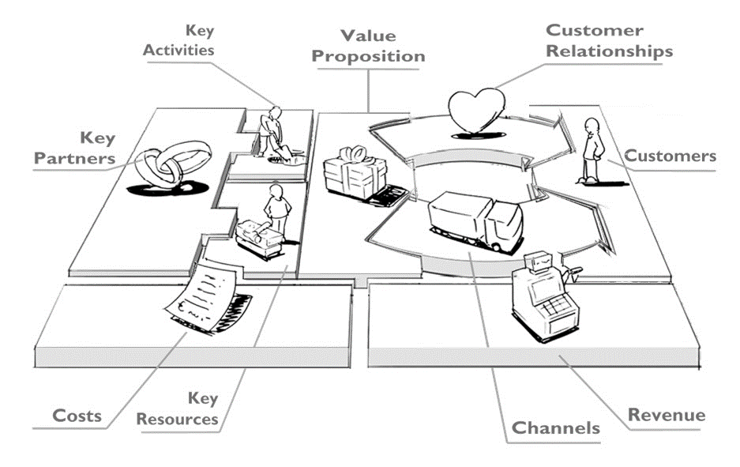
Book: Business Model Generation by Alexander Osterwalder

Slide 51
for taxi aggregator
Individual car owners
Transport operator
Digital wallet companies
Technology provider
Advertisement agencies
Driver association
Hardware provider
Manage booking
Optimize vehicle logistics
Maintain customer registration, travel record
Easy booking
Easy payment
Direction
Safety
Competitive rate (transparent)
Schedule tour in advance
No waiting
Pickup from home
No parking
Good interior
Security
Feedback
Loyalty bonus
Fidelity bonus
Segment by profession
People commuting daily
Working people
Tourist
Segment by age
People above 18 and below 70
Hardware
Software
Contract with key partners
Key employees
Phone App
Computer
Call center
Google advert
Sponsor event
Hardware cost
Software maintenance cost
Employee cost
Network / hosting / database server cost
Pay per ride
Registration fee, hardware rent
Advertisement on the App
Advertisement on taxis
Event contract

Slide 52
Criticism of Business Model Canvas
It does not have any reference to exogenous forces.
It focuses mostly on economic value and not environmental and social value.
How to create competitive advantages, entry barrier, scaling business and such.
Overly simplistic and narrow in terms of diversity of business challenges.

Slide 53
Osterwalder, A., & Pigneur, Y. (2010). Business model generation: a handbook for visionaries, game changers, and challengers. John Wiley & Sons.
Bocken, N. M., Short, S. W., Rana, P., & Evans, S. (2014). A literature and practice review to develop sustainable business model archetypes. Journal of cleaner production, 65, 42-56.
Toro-Jarrín, M. A., Ponce-Jaramillo, I. E., & Güemes-Castorena, D. (2016). Methodology for the of building process integration of Business Model Canvas and Technological Roadmap. Technological Forecasting and Social Change, 110, 213-225.
Icons from https://www.flaticon.com/

Slide 54
Business model canvas explains how a business creates and delivers values.
Clear understanding of business model is critical for success of a business.
Business model canvas is almost like a ready reckoner for conceiving various aspects of the business.
However, business model canvas is only a part of the understanding of challenges and opportunities of a business.

Slide 55
Thank you

